Slide 1
Zipline Data Scientist Project
-Antony Paulson Chazhoor

Slide 2
Contents
Project Definition
Diurnal Weather Patterns
Missing Data
Outlier Launches
Unexplained Behaviors
Possible Faulty Parts
ML model to predict flight location

Slide 3
Project Definition
WHAT?
Independent exploratory data analysis & visualization assignment to find patterns in the data
Why?
Communicate actionable insights to the engineering & operations team:
diurnal weather patterns
missing data points
individual outlier launches
unexplained behaviors
poorly performing parts

Slide 4
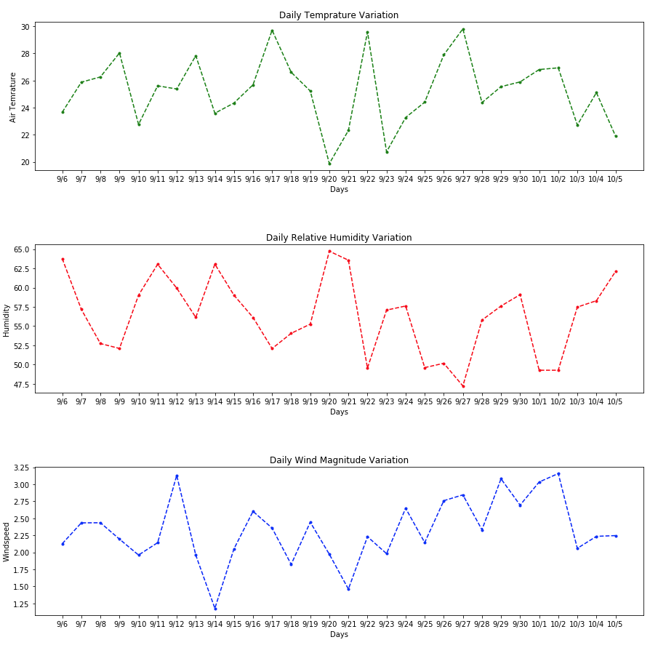
Diurnal Weather Patterns
Mean daily weather patterns were analyzed
Smooth horizontal patterns indicate diurnal repetitions
Air Temperature: Diurnal temperature patterns on
1st and 2nd October.
Additional approximate patterns:
11th and 12th of September, 29th and 30th September
Relative Humidity: Diurnal Humidity patterns on
1st and 2nd October.
Additional approximate patterns:
23rd and 24th of September, 25th and 26th September
Wind magnitude: Diurnal wind magnitude observed
7th and 8th of September
4th and 5th of October

Slide 5
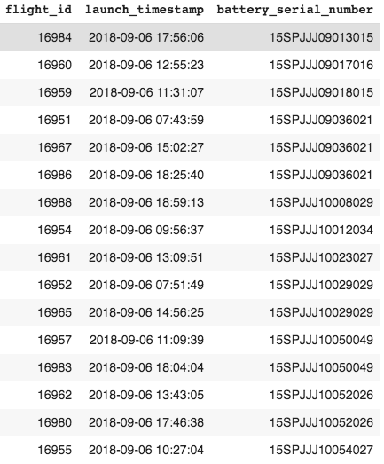
Missing Data
Pre-flight voltage data missing for the following flights launched on 6th September

Slide 6
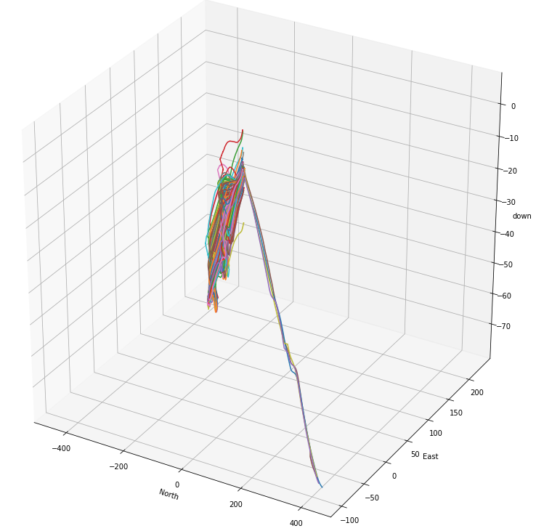
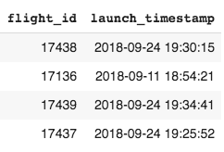
Outlier Launches
Flight launches tracked for all 447 flights based on the NED co-ordinates
Four flights found to follow an entirely different trajectory
These are definite outliers

Slide 7
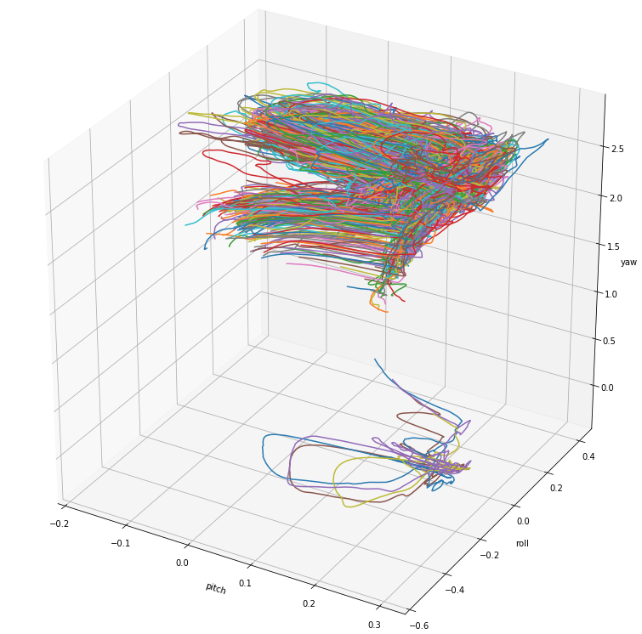
Unexplained Behaviors
The same 4 flights had negligible yaw
Can be clearly visualized in the 3-D plot
This usually indicates trouble with the flight rudder. But a deeper technical analysis is required

Slide 8
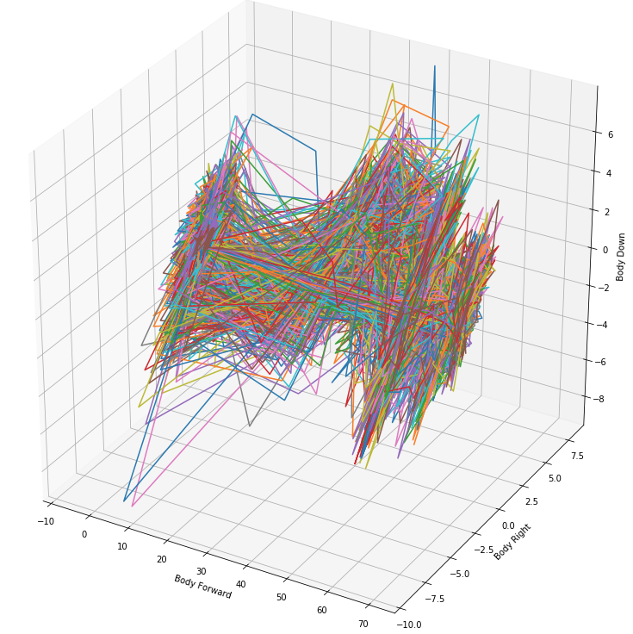
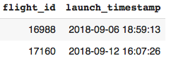
Unexplained Behaviors (contd…)
Two flights have highly negative acceleration in the Body Right direction.
May Indicate a faulty body part.
Further analysis in the faulty body parts section.

Slide 9
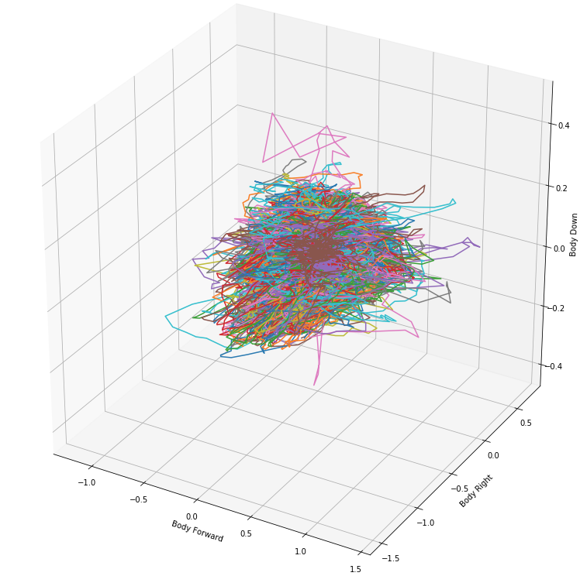

Unexplained Behaviors (contd…)
One flight has highly unstable angular Velocity.
It had both more than +0.2 rad/sec and less than -0.4 radians per second angular velocity in the ‘Body Down’ direction.
Further Technical Analysis required

Slide 10
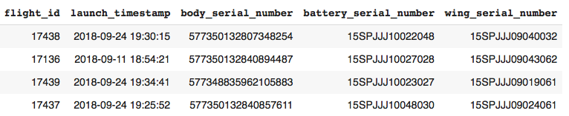

Faulty Parts
Body part details of flights with outlier launches & Yaw
Flights with Acceleration issues
Flight with outlier Angular Velocity
Wings 15SPJJJ09024061, 15SPJJJ11049056 appeared multiple times in outlier flights.
If resources are available batteries and body can also be investigated

Slide 11

Machine Learning Models(Additional)
The application of a machine learning model to predict flight location
NED Location 15s post a launch in the distribution center at Muhanga.
Multiple Linear regression model did not give satisfactory results
Decision tree however provides extremely promising accuracy scores with much lower RMSE and R-Squared values of 5.96 and 54% accuracy on the validation set.
If more data was available , the model can be trained better to make further improved predictions

Slide 12
THANK YOU
Please reach out to me in case of any questions and concerns regarding my project at antonypaulson@outlook.com

